Slide 1
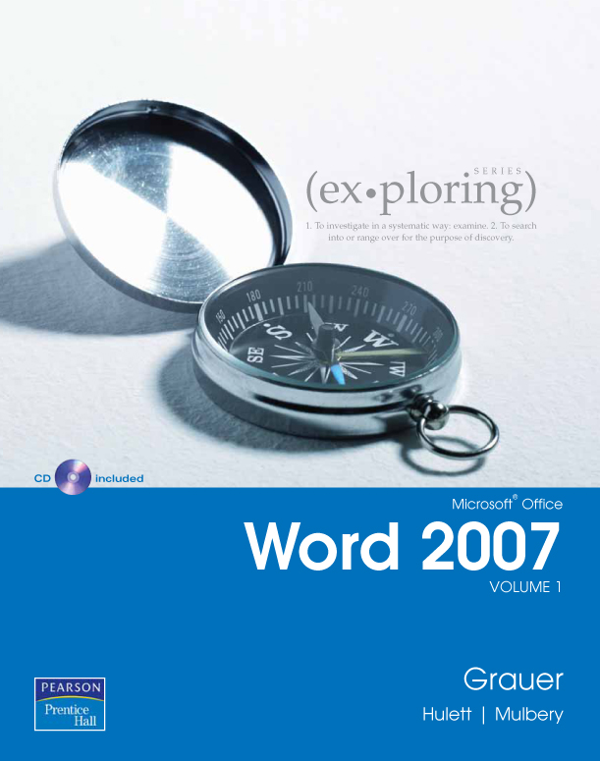
Exploring Microsoft Office Word 2007
Chapter 2:
Gaining Proficiency
Robert Grauer, Keith Mulbery, Michelle Hullet
Committed to Shaping the Next Generation of IT Experts.
Notes:
Microsoft Office 2007 includes significant table and graphic options that enhance your documents.

Slide 2
Objectives
Typography basics
The difference between paragraph and character formatting
Character editing options
Paragraph editing options
Using styles
Modifying styles and making new styles
Producing a table of contents and an index
Notes:
This presentation covers basic typography, character and text level editing choices, using styles to unify the document design, and setting up the table of contents and indexes.

Slide 3
Typography: Fontface Types
R
R
A serif
Times New Roman
is a serif font
Arial
is a san-serif font
Serif fontfaces have small features at the end of strokes within letters
San-serif fontfaces (without serifs) are simpler and have no extra strokes on the ends of letters
Notes:
Font designers have been producing new fonts for hundreds of years; however, they still fall into two overall groups—serif and san serif font families.
A serif font has ticks at the ends of the letters. This is an older font design that can be traced back at least as far as the Romans. The serifs, or feet, are remnants from original writing that was chiseled into stone. These are the beginnings and endings of the chiseled letters, so they were able to move into the stone on an angle.
San serif fonts are more modern, though also very old. They are simpler designs without the serifs, hence the name.
Serifs allow the reader to move more seamlessly from letter to letter, making it easier to read in body text.
San serif fonts are bolder and work well in headlines and onscreen. Since screen images are produced by dots of light, serifs can become dotty or blurry. This is becoming less of an issue with modern LCD screens.

Slide 4
Typography: Fontface Types (continued)
read
Courier
is a monospaced typeface
read
Arial
is a proportional typeface
A monospaced typeface uses the same amount of space for each letter
A proportional typeface uses varied space depending on the letter’s need
Notes:
Typewriters originally moved on the page the same amount for each letter. This is why monospaced typefaces look more like an old fashioned typewritten word. Each letter uses exactly the same amount of space, whether they are the letter i or the letter w.
Proportional typefaces, on the other hand, take differing amounts of space for each letter. It makes the words fit together and is much easier to read. Therefore the letter i can take up significantly less room than the letter w. Proportional typefaces look modern.

Slide 5
Typography: Type Styles
R
R
R
R
Regular
Bold
Italics
Bold Italic
Use bold (Ctrl+B) for emphasis, to highlight important points and create contrast for headlines and subheadings
Use italics (Ctrl+I) to create subtle emphasis and to set apart certain names and titles
Notes:
Within typeface families, there are many options. Generally, the options are regular, bold, italics and bold italic. Italic may also be called oblique. There may also be differing bolding options available. However, in Word, the options are restricted to bold, italic and bold italic.
There are good reasons to use bold and italics.
Bold gives information emphasis. This is a good choice for setting up headings. Bold tends to be used at the beginning of paragraphs to make it easy to scan though the document.
Italics creates a more subtle effect and is generally used to emphasize a word or few words within a paragraph.
Italics may be used to identify a published document’s name; for example, Time Magazine. When typewriters were used to produce documents, the author would underline the name and then—when a typesetter placed the text for printing—they would replace the underlined text with italics.
Avoid underlining in documents. It looks old fashioned on paper, and it is confusing onscreen, since it looks like a hyperlink.

Slide 6
Two Types of Formatting
Paragraph paragraph window | Character font window
Formatting applies to the entire paragraph | Formatting applies only to the selected characters
Examples: alignment, margins, indents, line spacing, and tab stop positions | Examples: Fontface, color, size and effects; and character spacing
Borders and shading can apply to entire paragraph | Borders and shading can apply only to character
Notes:
Word splits its formatting options into two major areas: paragraphs and characters.
Characters are the actual letters used to make words. To make character level formatting, select the entire group of characters to which the format should be applied. To make a change to a word, it will almost always be a character level formatting issue.
Paragraphs are the other building block of Word’s formatting process. Paragraph level formatting applies to the entire paragraph and cannot apply to only part of a paragraph.
A paragraph in Word is everything between one return and another. Use the show/hide button to see that a paragraph is set between two paragraph marks.

Slide 7
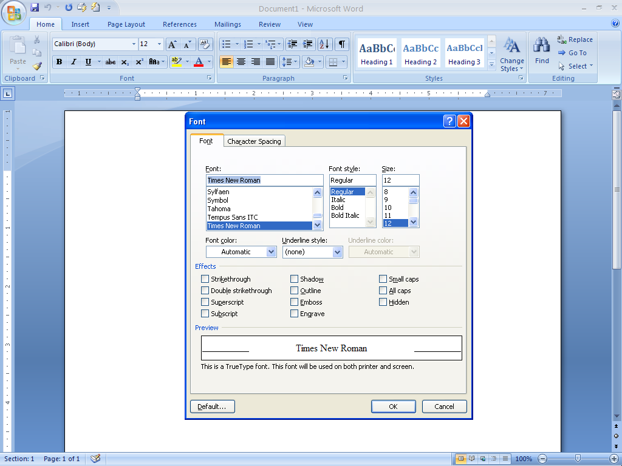
Character: Font Window
Click to open the font window
Type style
Font face
Type size
Font color
Use when underlining characters
Font effects
Preview box
Highlight text to be changed
Click the square on the Font group of the Home ribbon to get the Font dialog box
Notes:
To open the font window, click on the dialog box launcher on the font group.
The font window gives most of the formatting options available for character formats. Choose the font, type style, size and underlining options.
Choose a font effect, if appropriate. Look at the preview box to see how the font changes look before applying. Click OK to apply changes to the selected text.

Slide 8
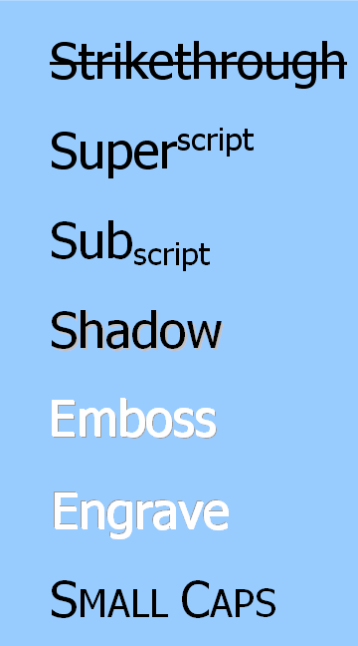
Character: Font Effects
Notes:
Effects available for fonts include strikethrough, superscript, subscript, shadow, emboss, engrave, and small caps.
Use strikethrough to include information that has either been changed or was part of a list and is no longer included, but should still be identified. Generally, strikethrough shows something that has been removed, but was available in a previous version.
Superscript shrinks the font size and raises the letter off the baseline. This can be used for items like 23rd, 2⁸, or a footnote/endnote.
Subscript also shrinks the font size, but lowers the letter; for example, a molecular structure H₂O (water).
Shadow, Emboss and Engrave are specialized options that should be reserved for only very limited purposes.
Shadow adds a drop shadow to the text. This is supposed to make the text look like its floating off of the paper.
Emboss and Engrave simulate lettering that has been pressed into paper, rather than having ink applied.
Small caps replaces small letters with capitals; however, the size is smaller.
All caps changes all lettering to CAPITALS.
Hidden hides text. This type of text will not be printed.

Slide 9
Character: Hidden Effect
Hidden
Hidden effect hides data that is inappropriate for printing
Perfect for confidential information
Notes:
The hidden effect is very interesting. This effect will hide the text to which it is applied so that it won’t print. This is a good effect to add to a document that has sensitive information, such as social security numbers. If the document is printed for external sources, the sensitive material isn’t printed.
To remove the effect, highlight the hidden text and remove the effect.

Slide 10
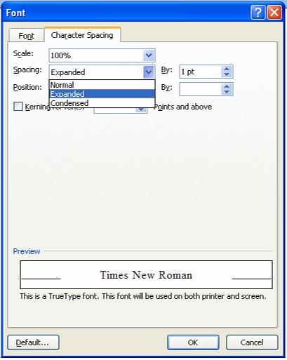
Character: Spacing
Scale – increases/decreases character width
Spacing – increases/decreases space between characters
Position – raises/lowers text from baseline
Notes:
Character spacing refers to the space between letters horizontally.
Scale of a character refers to how wide it is. The default is 100%, which is exactly how the letter was originally designed. Using a percentage over 100 will give a wider letter, while less than 100 will narrow the letter. The human eye tends to notice a change when scaling is greater than 110% (wider) or 90% (narrower).
Use spacing to give letters breathing room or to bring characters together more tightly. Expanded opens up space between letters, while condensed narrows that space. You can choose precisely how much space to add, using the “By” area.
Notice that type is measured in Points (pt). There are 72 points in an inch. For example, 12 point type is the default size of Word documents. A letter that is 12 points is 12/72 of an inch in height.
Position will either raise or lower the letters off the baseline of the line. The baseline is the imaginary line that letters sit on. Some letters, like g and j, fall below the baseline; however, most sit on the line itself.
Kerning is the art of spacing letters. When some letters, such as z and e are placed together, the empty space around the letters make them look odd, particularly at larger point sizes. Kerning fixes this problem. Word begins kerning with type that is larger than the size chosen here. The default is 14 points.

Slide 11
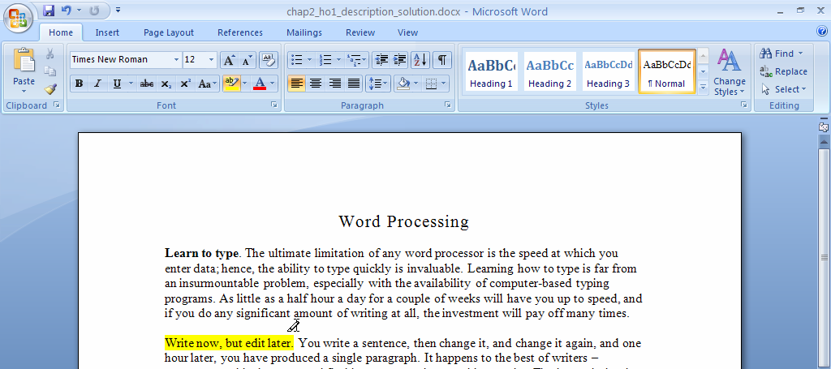

Character: Highlighting Text
Highlight button
Cursor changes
to highlight tool when on
Highlighting in Word, as in real life, helps ideas get noticed
The highlight button toggles on/off
Notes:
Highlighting text is a button on font menu that adds background shading to the text selected. Choose a background color. This works very much like a highlighter pen in a textbook. Use highlighting to emphasize text.
The highlighting button is a toggle which turns on the tool to select the text to highlight. When the highlight tool is on, all selected text will be highlighted. To turn off highlighting, click the button again.

Slide 12
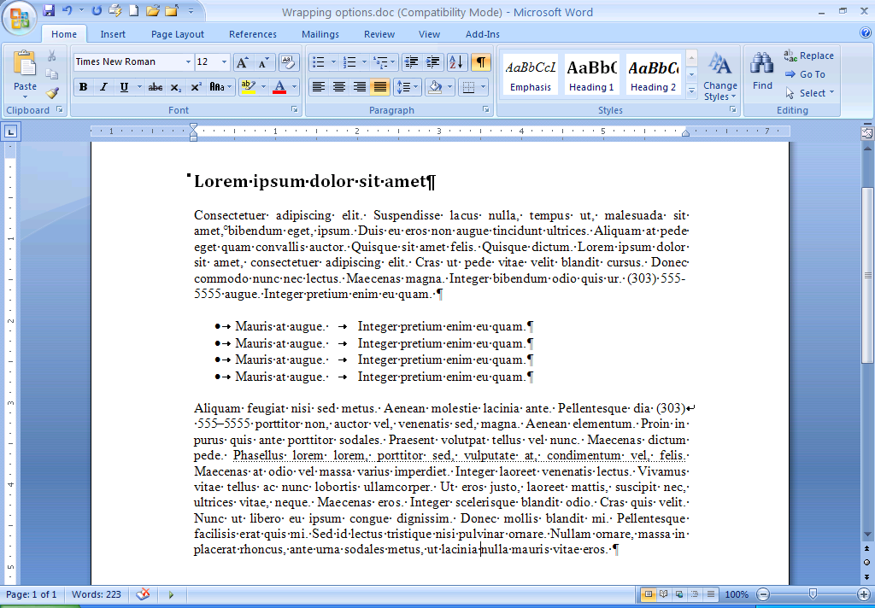
Show/Hide Button
Show/Hide on
This dot identifies a heading style
The end of a paragraph
White dot is a non breaking space
Regular hyphen
These dots are spaces
Line break
Non breaking hyphen
Tabs
The show/hide button reveals formatting
Toggles on and off
Off—how the document looks when printing
Notes:
On the Home ribbon in the paragraph group, select Show/Hide. Show/Hide is a toggle allowing background formatting information to be seen onscreen. This information does not print.
All spaces are shown as dots.
Non breaking spaces are shown as a small circle.
Non breaking hyphens are shown as longer hyphens; however, they print like regular hyphens.
Tabs are shown as arrows.
A paragraph is all the text between two paragraph marks.
Line breaks are shown as a circular arrow.
Show/hide can help identify problems. It is a good idea to have Show/Hide on when setting tabs.

Slide 13
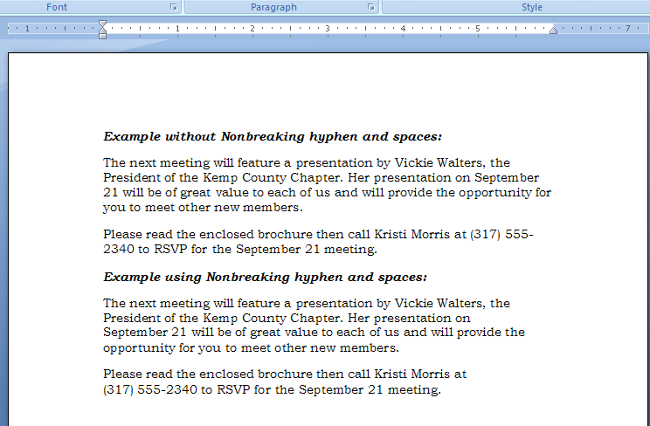
Character: Non Breaking Space
Breaking space
Becomes a
non breaking space with Ctrl+Shift+spacebar
Use a non breaking space when it isn’t appropriate for the space to break across lines
Ctrl+Shift+spacebar produces the non breaking space or select it from insert >symbols
Notes:
Ctrl+Shift+spacebar produces a non breaking space. When Show/Hide is on, the non breaking space is identified as a small circle. A non breaking space is used when information containing spaces should not be broken up, as when line wrapping occurs. The example here is the address. An address is easier to read when it is all together; however, since there are spaces in it, type each space as non breaking and the entire address is treated as a single word.

Slide 14
Character: Non Breaking Hyphen
Breaking hyphen
Becomes a
non breaking hyphen with Ctrl+Shift+hyphen
Use a non breaking hyphen when it isn’t appropriate for a hyphen to break across lines
Ctrl+Shift+hyphen produces the non breaking hyphen or select it from insert>symbols
Notes:
Hyphens are treated as spaces by word wrap. Type Ctrl+Shift+Hyphen to add a non breaking hyphen, which is a hyphen that shouldn’t break at the end of a line, for example, in a phone number. The entire phone number is then treated as a single word.

Slide 15
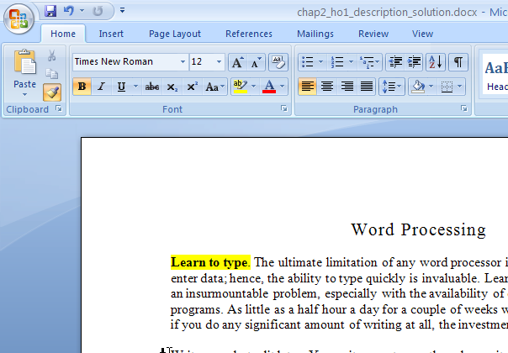

Format Painter
Format Painter
Choose text or paragraph that displays the formatting to be copied
Painter tool
Select text or paragraphs to be formatted
Single click to apply the format once
Double click to apply format multiple places
Select text to apply only character formatting
Select entire paragraphs to apply paragraph formatting
Notes:
Format Painter is a great tool to use to make format changes across the entire document.
Select the formatted text that contains the formatting to be applied to other places in the document. On the Home ribbon, in the Clipboard group, choose Format Painter. Click Format Painter once to apply the formatting to only one other place in the document. Double click Format Painter to leave it on and apply the formatting to multiple places in the document. Finally, select the text to which the selected formatting is to be applied.

Slide 16
Formatting a Paragraph
Paragraph level formatting applies to the entire paragraph
Even when an entire paragraph is not selected, the format paragraph commands affect the entire paragraph
Notes:
A paragraph format must apply to the entire paragraph. When the enter key is used to start a new paragraph, the previous paragraph’s formatting applies to the new paragraph as well.
Examples of paragraph formatting options are:
Alignment
Indention
Line spacing
Paragraph spacing

Slide 17
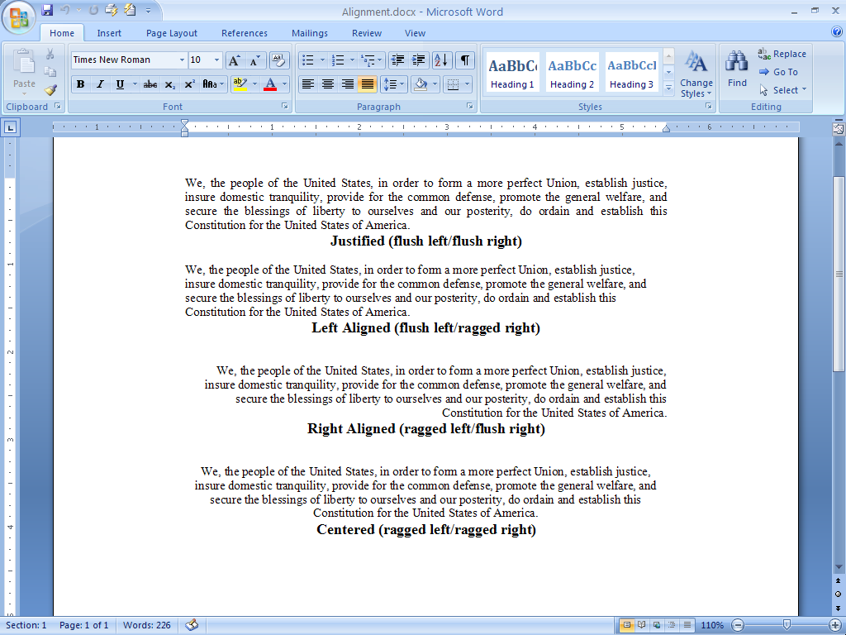
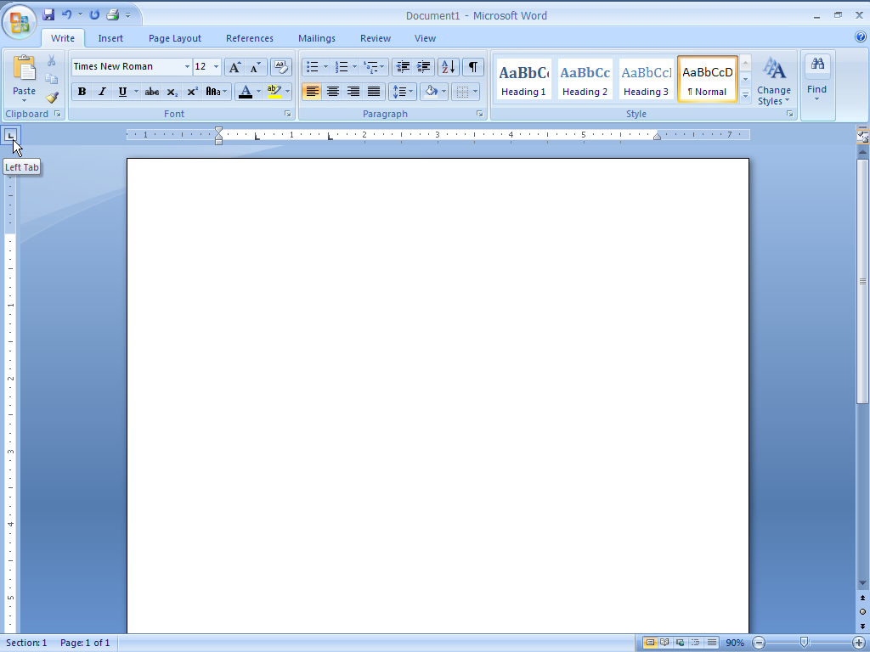
Paragraph: Alignment
Left aligned
Justified
Centered
Right aligned
Notes:
Align paragraphs between margins.
Left aligned is the default alignment option. Here, the left side of the paragraph is aligned, while the right-hand side is ragged. This is easiest way to read the English, French, Spanish and other languages which are set from left to right. The eye is given a line to read from left to right, but must find the next line without help.
Right alignment lines up the text on the right-hand side of the body and the left is left ragged. This alignment works well for numbers, allowing them to line up by units, tens, hundreds, etc. Right alignment should be used sparingly when writing in left to right scanning languages. However, in Arabic or other languages printed from right to left, right alignment would be easiest to use.
Centered alignment is also known as ragged right and left. This is the hardest to read because the eye has no defined target from line to line. Reserve this alignment for short pieces of text, like headlines.
Justified paragraphs align both sides of the text. This is achieved by adding space between words. This causes problems if the lines are short (as in columns), but works nicely when lines of text are longer.

Slide 18
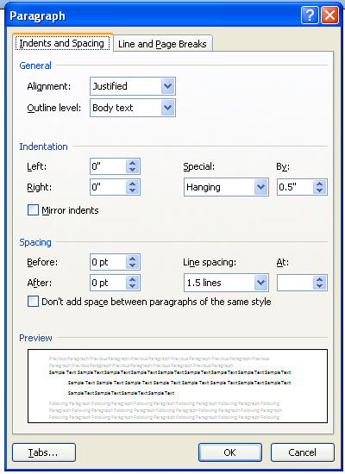
Paragraph: Indention
Open paragraph window
Indent entire paragraphs
First line indents – the first line indents to the right of the rest of the paragraph
Hanging indents – the first line hangs out to the left of the rest of the paragraph
Mirror indents will indent on the left and the right
Notes:
Paragraphs are written from margin to margin. However, when text needs to be offset from the body of the document, change the indention.
Options for indenting are:
Indent entire paragraphs to offset the whole paragraph. This is the indention that should be used, for example, with a long quote in a document.
Set the first line to indent
Set a hanging indent
Indenting is the way paragraphs used to be offset. Many remember having to add five spaces at the beginning of each paragraph. This is a normal first line indent. After the first line of a paragraph, text will again go from margin to margin.
Hanging indents are also known as dictionary indents. This is the opposite of the normal first line indent. The first line is set to start before the rest of the document, and when the paragraph wraps to a new line, it will then be indented. This form of indenting allows for easy scanning, as in a dictionary.
Finally, choose mirror indents to indent equally on the left and the right. This option is for use with full paragraph indents, not first line or hanging indents.

Slide 19
Paragraph: Line Spacing
Open paragraph window
Line spacing area
Use line spacing to set spacing between the lines themselves
Examples include single spaced and double spaced
Notes:
Line spacing is a paragraph level formatting choice.
To double space a document, simply select the paragraphs to which to apply the spacing option, and choose double from the line spacing drop down menu. Other options include 1.5, which adds half again as much space as single spaced.
Don’t double space business documents, such as letters and reports. The rule of thumb should be, if the document needs to be line edited, then double space. Examples of documents to be double spaced are transcripts, rough drafts for editing, your English paper, etc.
If the document doesn’t need to be edited, use single spacing unless it is for a specific design.

Slide 20
Paragraph: Paragraph Spacing
Open paragraph window
Paragraph spacing area
Use the Before and After area to add space between paragraphs
Can eliminate double returns between paragraphs
Notes:
Add space between paragraphs to identify where a paragraph ends. Most people type double return between paragraphs; however, you can automate this by simply adding space to before and/or after the paragraph. This gives paragraphs some room and since many documents no longer use first line indents to offset paragraphs, it is a good way to define paragraphs in the document.
When applying paragraph spacing to a style, pay particular attention to how it will interact with other styles. If a heading is set to have 12 pts after and the Normal paragraph has 12 pts of space before, there will be 24 points between a heading and a normal paragraph. That is quite a lot of space.

Slide 21
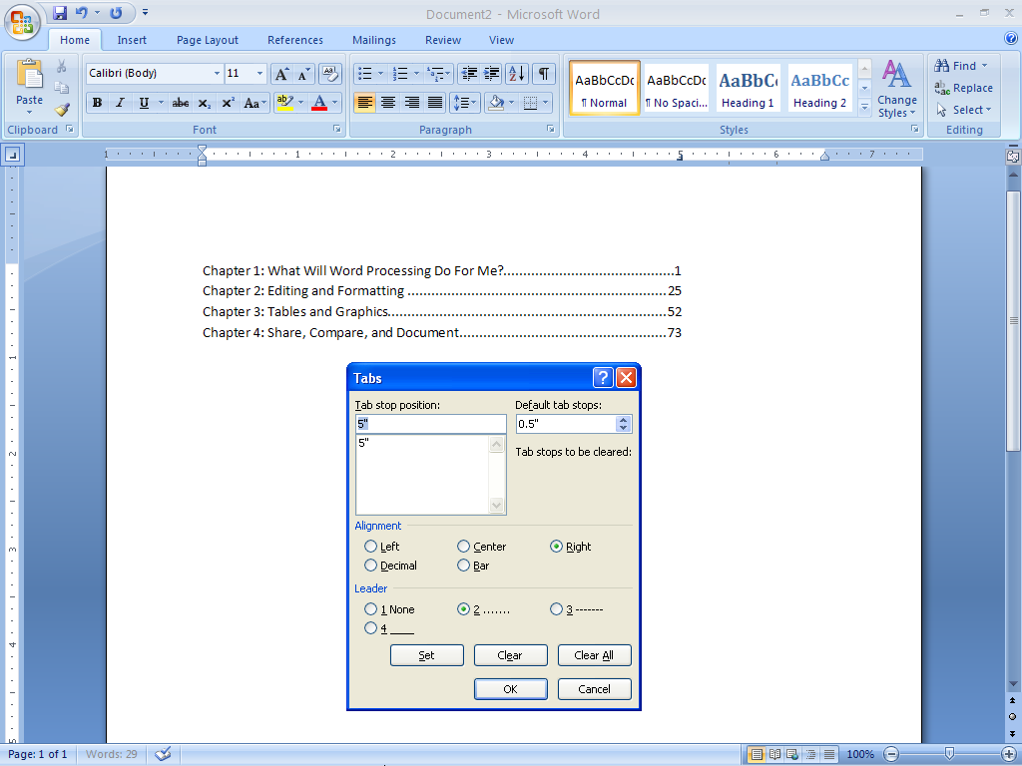
Paragraph: Setting Tabs
Tab stop on ruler
Set tab stop positions
Default tab stops
List of set tab stops
Alignment of set tabs
Leaders for set tabs
Default tabs are the space between tabs when no tab has been set
A set tab replaces default tabs with a single tab
Default tabs continue after a set tab
Notes:
Tabs may be used to achieve a columnar form without using a table. Most people simply use the tab key multiple times to space items. This isn’t the best way to set up tabular data.
Tab stops originally were little metal pieces on a typewriter’s ruler that moved, to indicate where the typewriter was to stop. Word can do much more with tab stops.
There are five types of tabs: left, right, center, decimal and bar.
To make a tab move to a specific place on a line, set a tab for optimal control.
Before setting tabs, first type ONE tab between each item to be set in the columnar tab system. Do not type more than one tab between columnar information or the tab system will not work. Tab stops only apply to tabs; therefore, you must have tabs in the information.
Tab stops are paragraph level, so all paragraphs or lines that need to have tab stops applied MUST be selected before setting the tabs. Once tabs are set on a paragraph, they are applied to future paragraphs when the enter key is used from the paragraph with the tab stop.
Once the paragraphs are selected, click the Paragraph box on the Paragraph group of the Home ribbon. At the bottom, select the Tab button. Type in a tab stop position. Choose the alignment option and a Leader, if appropriate. Click the Set button.
The Tab stop will be added to the list below the Tab stop position area. Enter as many tab stops as needed. Click OK. The tab stops will be applied.

Slide 22
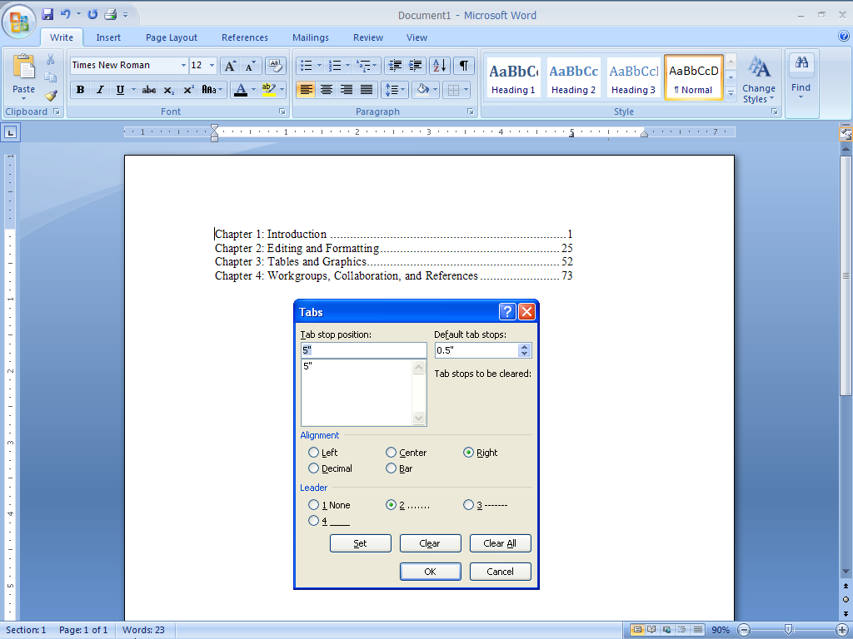
Paragraph: Tab Types
Alignment options: left, center, right, decimal, and bar
Notes:
On the Tab dialog box, tab stops may be set with different alignments:
Left tabs (the default) start at the tab, and the text continues to the right. This aligns the text to the left.
Right tabs move to the tab and text backs up, so it aligns on the right.
Center tab starts at the tab and continues to center the text on the tab by moving both left and right as text is entered.
Decimal tabs are for numbers and align at a decimal to line up units, tens, etc. to the left; and tenths, hundredths, etc. to the right. Decimal tabs align on a period as though it were a decimal point.
A Bar tab adds a line at the tab.

Slide 23
Paragraph: Tabs with Leaders
Dot leader
Leader options: replace empty space leading up to the tab with either dots, dashes, or a line
Notes:
Replace the empty space leading up to the tab with a leader. Choose either dots, dashes, or a line. This helps the reader identify which row of columnar information goes with what. It adds a horizontal component to the information.
Note: To make any changes, highlight ALL of the paragraphs to which the tab stop has been applied. The changes will be made only to those paragraph(s) selected. If the insertion point is in a paragraph, it will apply only to that paragraph.

Slide 24
Paragraph: Tabs on the Ruler
click on ruler to place the default tab style
(displayed in the square at the beginning of the ruler)
in that position
Click here to cycle through tab and alignment options
Click through ruler items in the square
Click on the ruler to place the tab
Remove the tab by dragging it off the ruler
Grayed out tabs mean different tabs have been set on the selected paragraphs
Notes:
A quick way to set a tab stop is to simply use the ruler.
Click the square on the left-hand side of the ruler. This will show each item that may be added to the ruler. Place the mouse over the square and Word will identify the component. The one showing on the slide is a left tab.
Click through the components, exposing the one to be added to the ruler.
Before beginning, turn on Show/Hide to see the tabs in the document.
Be sure tabs are placed with the tab key in each of the lines (paragraphs) to set the tab stops. If there are no tabs, there is nothing to which to apply the tab stops.
Highlight the paragraphs that need to have tab stops set up.
Click the ruler where the tab stop is to be set and a tab stop is set for all of the highlighted paragraphs. Notice how the paragraphs’ tabbed information moves.
Double click on the tab on the ruler to quickly open the tab window.
To move a tab on the ruler, highlight affected paragraphs and them simply drag the tab to the new position. If you forget to highlight the paragraphs, then only the paragraph where the insertion point is will change.
To remove a tab stop, highlight the affected paragraphs and pull the tab off the ruler by dragging down and releasing the mouse button. When the button is released, the tab will be gone.
When a group of paragraphs are highlighted, and the tabs on the ruler are gray, you know that the paragraphs have different tab stops positions set up. Double click a tab to apply it to all selected paragraphs (and it will turn black) or drag inappropriate tabs off to remove them.
If the tab stops are not functioning correctly, use the clear all button in the tab window to delete all tab stops and start over.

Slide 25
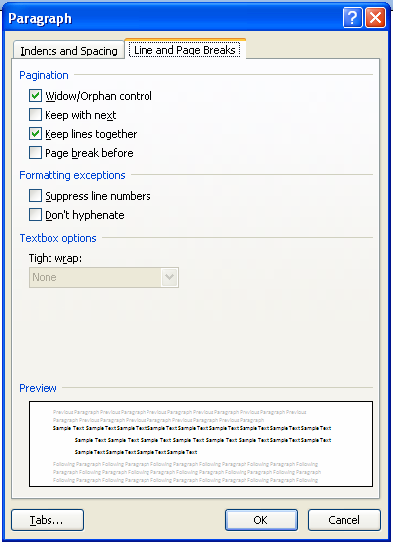
Paragraph: Preventing Awkward Breaks
Widow/Orphan control prevents single words and partial words at the end of paragraph from continuing on their own line
Keep with next will keep the paragraph with the next one. Use this to keep headings with the first paragraph below
Keep lines together keeps lines in a paragraph together
Page break before will start a paragraph on its own page
Notes:
Paragraphs can end awkward. To keep this from happening automatically, use the Line and Page Breaks tab in the Paragraph dialog box.
Widow/Orphan control keeps single words and partial words from ending on their own lines or worse yet, from ending on a new page. When this is checked, Word will move at least two words to the new line at the end of a paragraph. If it has to move a line to a new page, it will take two lines. This makes the document look more professional.
Keep with next needs to be used when a heading is set up in a document. When this is selected for the paragraph, it moves with the paragraph below to a new page, rather than, for example, be the last line on the page. This makes sure headlines are above the correct text.
Keep lines together is similar; however, this can be used to keep lines together no matter what. This would be a perfect choice to apply to a multi-lined address in a document.
Finally, Page break before might be added to a heading that acts as if it were a section or chapter title. This forces the heading to start on a new page.

Slide 26
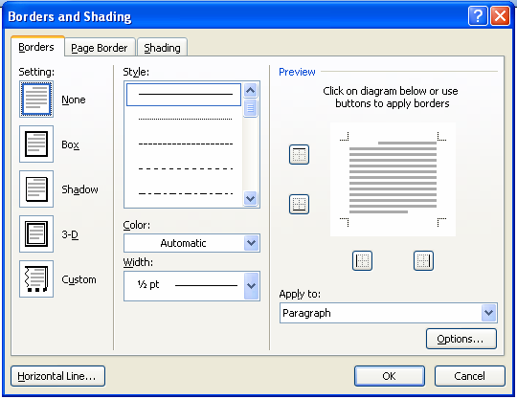
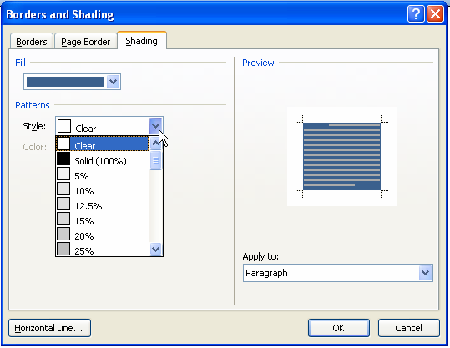
Borders and Shading
Choose to apply to paragraph or text
Borders and Shading can be applied to separate characters or paragraphs
When applied to characters, it will surround only the selected text
When applied to paragraphs, it will go from left indent to right indent for the entire paragraph
Notes:
Borders and Shading may be applied to characters or paragraphs (or tables or cells).
When Borders and Shading is applied to characters, it will apply only to the selected text within the rectangle. The highlight key is a shortcut to adding shading behind text.
To add borders or shading to a paragraph, the choices will be applied from indent to indent (or margin to margin if no indent has been made) as a rectangle. Shades again apply behind the text.
You may place borders on all sides of the characters or paragraphs, or choose to apply them only to certain portions. For example, adding a simple line on the left of an indented section will make that section stand out without removing it entirely from the rest of the text by bordering it on all sides.

Slide 27
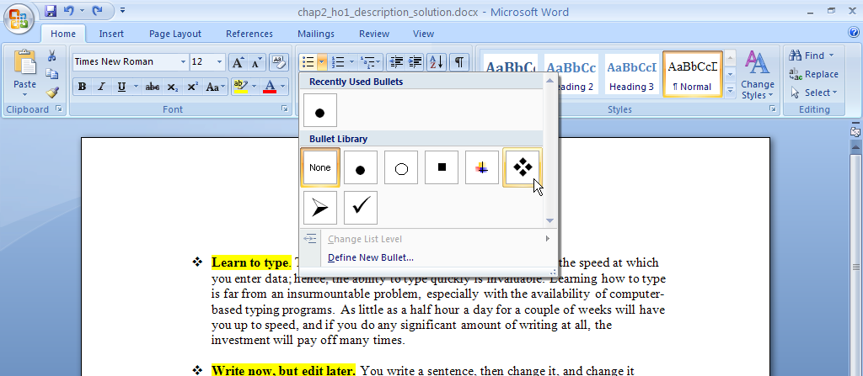
Paragraph: Bulleted Lists
Bullets apply to each paragraph
Use increase and decrease indent buttons to change the outline level
Notes:
Bulleted lists are a way to identify list items in no particular order. Bullets and numbers are both paragraph level changes.
Use bullets to list items without a hierarchy; however, use numbers when hierarchies are necessary (first, second, third, etc.).
Identify an internal list—a list within a list—by using the increase indent and decrease indent buttons. This will provide the second level of bullets in a group and indent the secondary list so it is identified as subsidiary to the item in the upper level list.
Use bullets and numbering to produce an outline; however, this is different from the outline view.

Slide 28
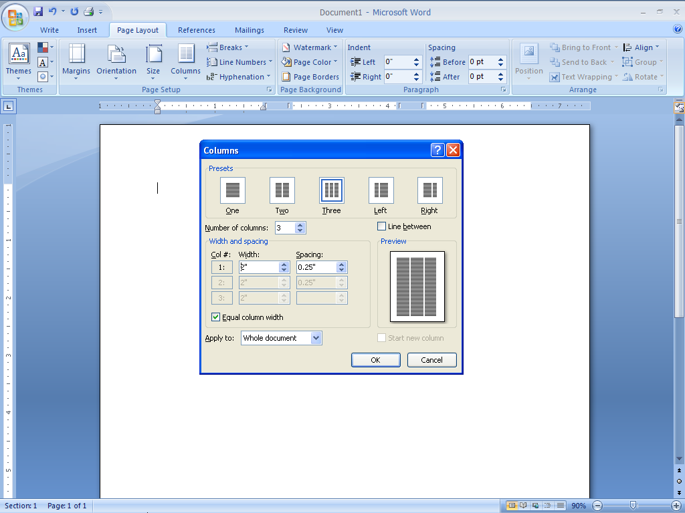
Paragraph: Columns
Column button
Preset options
Add a line between columns
Make your own
Each can be different widths
Apply to choices
Gutter between columns
Columns can be applied to the entire document, sections or highlighted paragraphs
Use column breaks to force content into a new column
Notes:
Columns can be added to a document in a section, or applied to the entire document.
Add either a preset column design (singe, double, triple, left and right) or make a new one.
Columns have two parts—the column itself and the gutter between columns.
Set up either equal column widths or different widths for specific columns.
For control over where the column breaks, insert a column break at the point the content needs to move to the next column.
Note: When adding a graphic in the middle of a document with text that wraps around both sides, first set the text in columns, and then place the graphic on the gutter. Word will then wrap the text in so it is easier to read, because the viewer moves down one side of the graphic and then to the other side of the graphic (rather than reading though the graphic). Open any magazine that uses columns, and notice how wrapped graphics are placed on a gutter between columns to make it easier to read around.

Slide 29
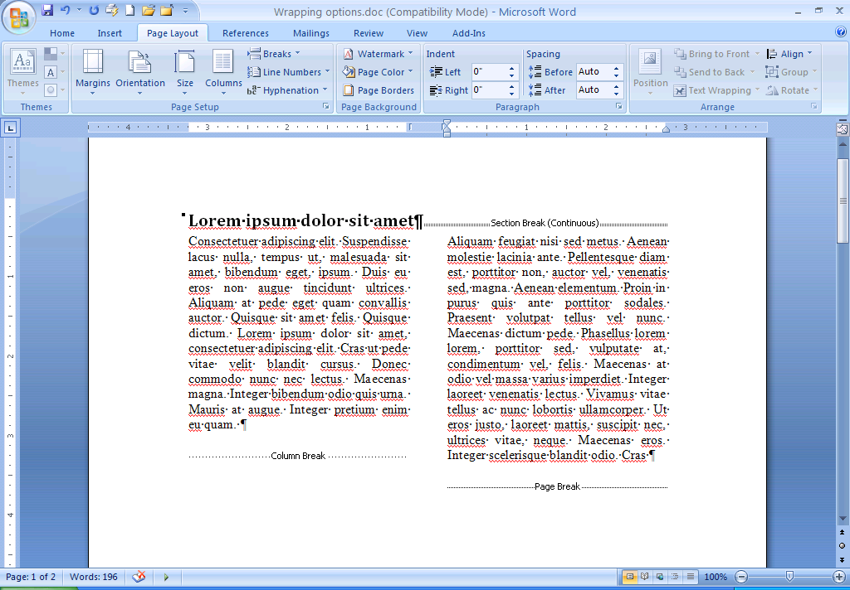
Show/Hide Button
Section break starts the columns area
Column break is set where a column should end in
the text
Page break
The Show/Hide button will easily reveal all breaks
Notes:
The Show/Hide button shows more background information. Page breaks, Section breaks, and Column breaks are all visible with Show/Hide on.

Slide 30
Using the Ruler
Tab square
Left indent
Right indent
Center tab
Hanging indent with tab system
Column gutters
The ruler will give information on the selected paragraphs
Use the ruler to place tabs and change indents and column gutter widths
Notes:
The ruler gives information about the paragraph where the indent point is. Move the insertion point from paragraph to paragraph to see changes on the ruler. The ruler shows paragraph level formatting.
Margins are shown as the gray area on the ruler. Place the cursor on the line between the gray and white area. Click and drag to move the margin.
Indent and word wrap is the white triangle pointing up, attached to the square. Click and drag to move the indent and word wrapping point.
First line indent is the white triangle pointing down—notice when it is to the left of the regular indent, it is a hanging indent and when it is to the right, it is a traditional first line indent.
Tabs are one of the following:
an L shape—left tab
a backwards L shape—right tab
an upside down T—center tab
an upside down T with a dot—decimal tab
a line for the different tab options—bar tab
column gutters, which look like multiple margins
Move, remove or add these items. Remember each item—except for the margins—is paragraph level formatting and can change depending on which paragraph the insertion point is in. If multiple paragraphs are selected and the ruler items are different from paragraph to paragraph, only the first paragraph’s items will be shown grayed out.

Slide 31
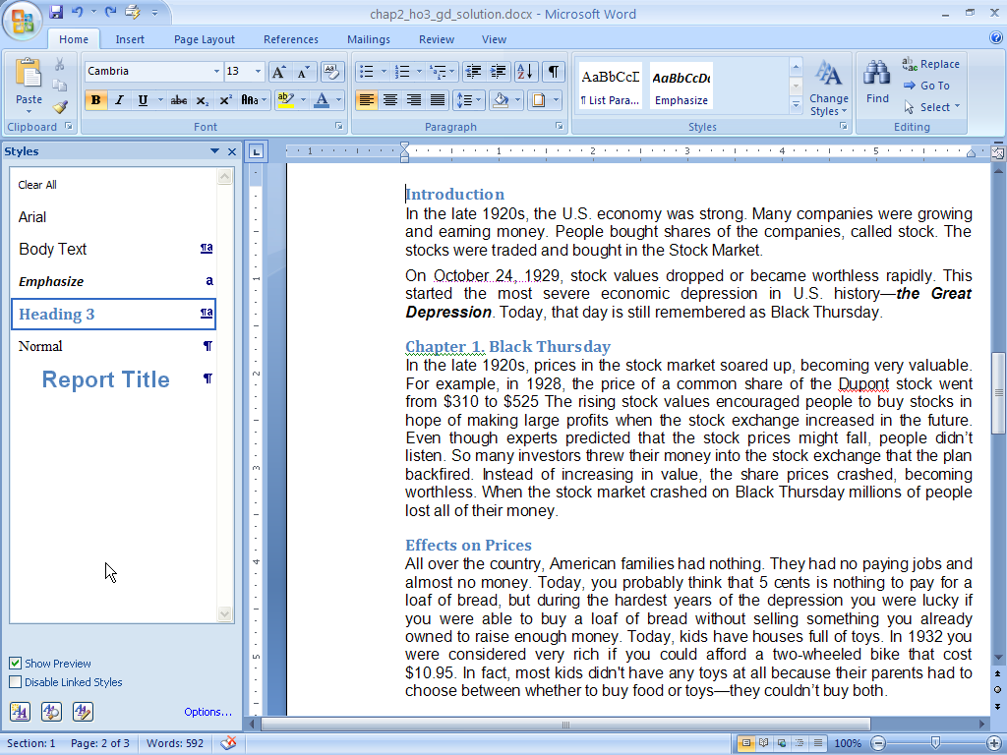
Styles: Paragraph vs. Character
Both character and paragraph style
Click to get the styles window
Character style
Paragraph style
Paragraph styles apply to entire paragraphs
Column styles apply to only the characters selected
Character and Paragraph styles apply to entire paragraphs just as the paragraph style
Notes:
Styles are groups of formats which may be applied to different parts of the document. Using styles to make format choices unifies the document design and when changes to a style is made, the style can update throughout the document.
Because setting up styles deals with formatting, character and paragraph style types are available. A hybrid style type called character and paragraph also exists and should be treated as a paragraph style type.
Paragraph and character and paragraph styles apply to entire paragraphs, while the character style can apply to individual characters.
Character styles may be applied inside of a styled paragraph, so a part of a document may have multiple styles applied.

Slide 32
Styles: Applying a Style
Click to get the styles window
Highlight text for the new style
Open the style window
Choose a style
Notes:
To apply a style, select the appropriate text, and then open the style window. Click on the selected style, and it will be applied to either the text selected (character style) or the paragraph (paragraph style).
Word’s default style is Normal. To make a global change to a document, make changes to the Normal style. If other formatting changes have been made, the style may not apply to those areas.
To remove styles, select the paragraphs and choose Clear All. Those paragraphs will revert to the Normal style.

Slide 33
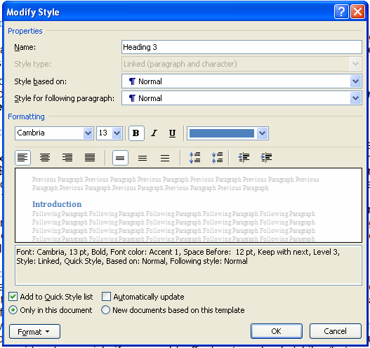
Styles: Modifying a Style
Style name
Style type based on format choices
Example of the style when its applied
If the underlining style changes this style will change as well
Use Format button to make the style changes
The following paragraph will be this
When modifying a style, the changes update every place the style is applied
Notes:
To modify a style, click the down arrow next to the style on the Styles menu. Choose Modify the style.
Keep in mind that if the style is the basis for any other style, any changes made may change those styles as well.
To make a change, use the format button to get to the character and paragraph area.
If a paragraph change is added to a character style, it becomes a character and paragraph style. The same is true if a character change is added to a paragraph style.
You can make changes to Font (character changes), Paragraph, Tabs, Borders and Shading, Language, Frame, and Numbers.
Adding a shortcut key (F key) makes using the style as simple as typing the shortcut key.
Choose what style will follow the paragraph to which it is applied. This will ensure that headings aren’t continued into the next paragraph.

Slide 34
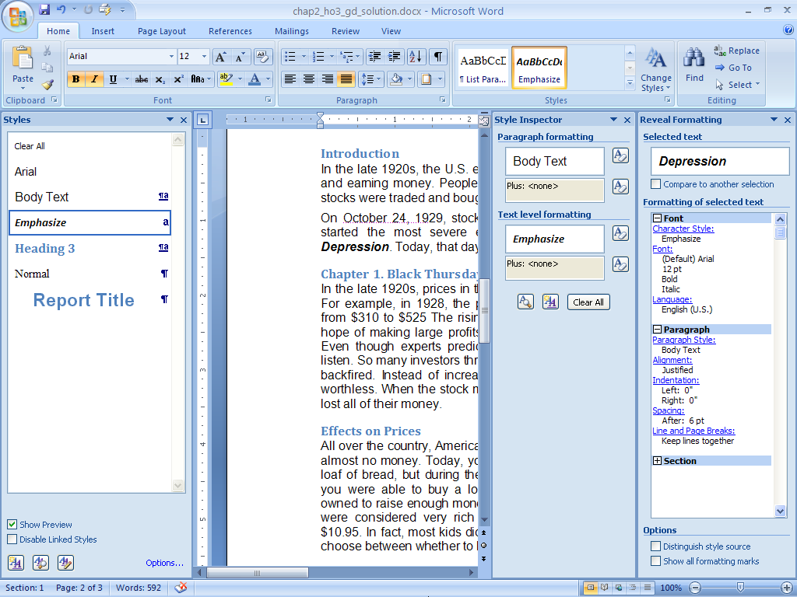
Styles: Reveal Formatting Task Pane
The selected text
Reveal Formatting button
Click the +/- next to each item to see the formatting for font, paragraph and section
Style Inspector button
Identify all styles applied to a selection through the Reveal Formatting task pane
Use to troubleshoot styles
Notes:
If there are problems in the document formatting, open the Reveal Formatting task pane. Select some text to see what styles have been applied to the text. This may reveal conflicting applied character and paragraph styles or other formatting issues which are difficult to identify without seeing what styles have been applied.
To open Reveal Formatting, click on the Style Inspector button in the Styles group on the Home tab and click Reveal Formatting button on the Style Inspector dialog box.
Use the plus and minus buttons to open the tree and see what styles are applied at the character, paragraph and section levels.

Slide 35
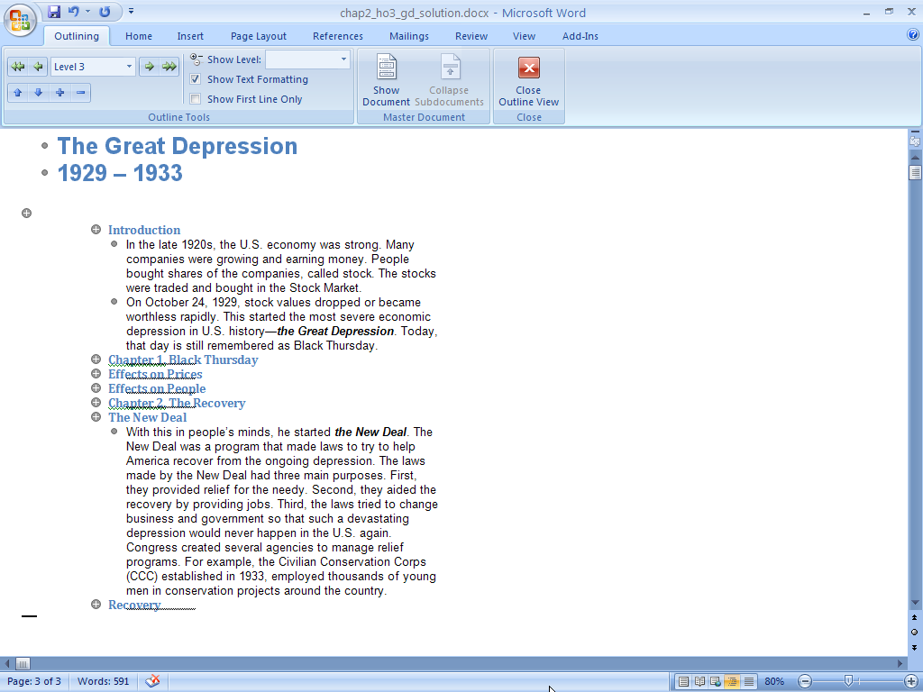
Styles: Outline View
Displays structural view of the document based on the headings applied
Move sections by simply dragging and dropping on the outline view
Notes:
Outline View is not for producing outlines. It utilizes the heading styles applied to a document to provide an overview of the document. On the View ribbon in the Document Views group, click Outline. The Outline View turns style headings into a bulleted list.
Outline View allows moving entire areas of the document around by simply moving the bullets. However, before using this tool, be sure the document styles are set up correctly.

Slide 36
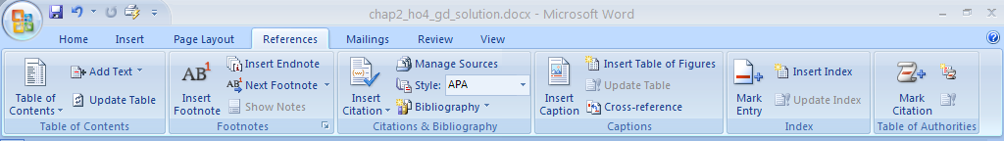
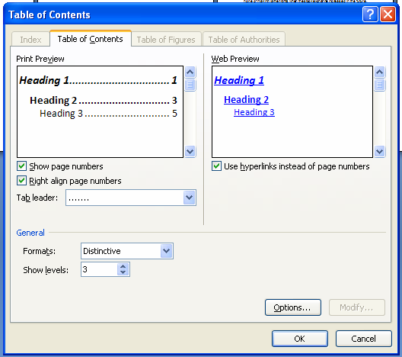
Table of Contents
Click for the built in TOC tool. Use the “insert table of contents field” to open the Table of Contents window
Choose the leader
Use the options button to change the styles used to generate the TOC
Table of Contents (TOC) automatically generates based on the heading styles applied in the document
Notes:
A Table of contents can be automatically generated using the hierarchy of heading styles that have been set up in the document. On the References ribbon in the Table of Contents group, select Table of contents. Either use the default system, or use the Options button to identify the styles to be used as a basis for the Table of contents. Choose a leader for the table.

Slide 37
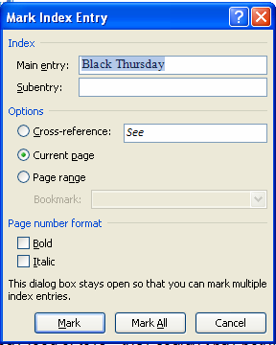
Creating an Index
Insert the index first
Use Mark All to find all entries for the term
Then mark entries
Word adds an index to the document and alphabetizes it
To add content, use “Mark Index Entry” window
Notes:
Indexes can also be created automatically.
First, insert an index into the document. Then mark the entries to be inserted.
Add the words, and then use the Find all entries for the term to quickly identify all references to the word. Remove references that aren’t appropriate.

